Slide 1
Data Science für Sportveranstaltungen
FH Kärnten & DIH Süd
27.09.2021

Slide 2
Agenda
Begrüßung
Sportveranstaltungen als Datenlieferant
Erfolgsstories im Sportbusiness trotz (oder gerade durch) Pandemie
Beispiele für Data Science im Sport
Pause
Beispiele für Data Science in der Logistik
Diskussion Datenschutz rund um Teilnehmer*innendaten
Neue Möglichkeiten für den Sportveranstalter durch Data Science

Slide 3
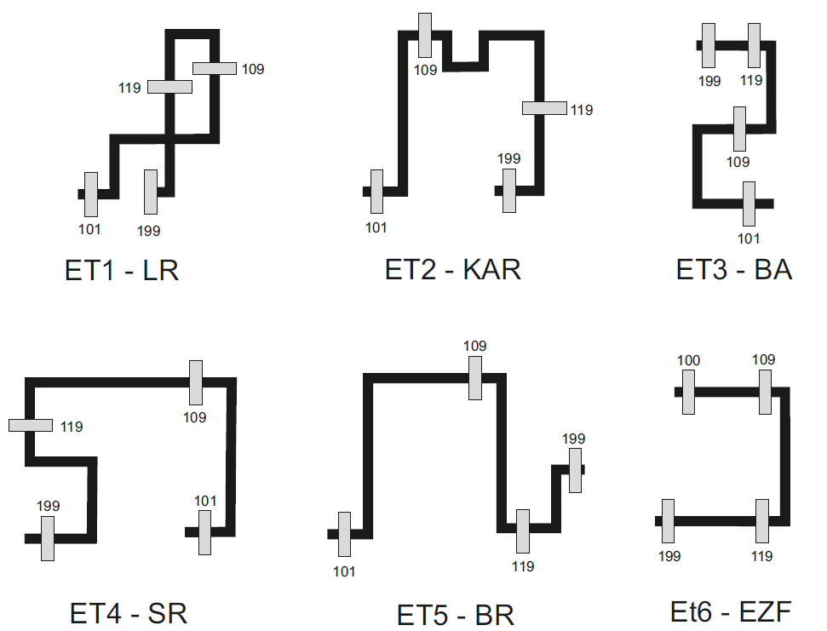
Sportveranstaltungen als Datenlieferant

Slide 4
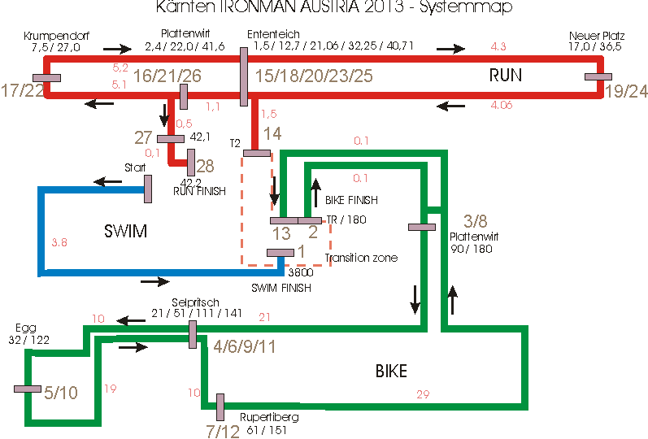
Sportveranstaltungen als Datenlieferant

Slide 5
Sportveranstaltungen als Datenlieferant
Different error types and order -> difficulties -> challenges to D.S.
Technical failures (RFID detection, communication or power break down)
Wrong settings in the Timing Point
Athletes wear wrong assigned chips
Athletes are wrong assigned to course/category/gender
Missinterpreted course configurations
Wrong directed athletes by volunteers or spectators
Athletes mistakes (disorientation or cheating)

Slide 6
Sportveranstaltungen als Datenlieferant
Linear uninterrupted competition
Start
Finish
Linear interrupted competition
Start
Finish/Start
Finish/Start
Finish
Repetitive competition
Start
n (?) laps
Finish
Athletes pass Finish Line

Slide 7
Sportveranstaltungen als Datenlieferant
Linear Moving Finish Line
Start->Finish
Finish Line passes Athletes

Slide 8
Sportveranstaltungen als Datenlieferant
Classical „Best in Time“ Competition
Distance
Limited by distance
Fast Athlete
Slow Athlete
Time
Gun Time
First passing
Last passing

Slide 9
Sportveranstaltungen als Datenlieferant
Alternative „Best in Distance“ Competition
Distance
Farest Passing
Nearest Passing
Fast Athlete
Slow Athlete
Time
Gun Time
Limited by time

Slide 10
Sportveranstaltungen als Datenlieferant
Moving Finish Line Profile
Distance
Speed n
Farest Passing
Nearest Passing
Endurance Athlete
Speed 1
Speed 2
Average Athlete
Time
Gun Time
Finish Line starts moving
Speed change
Speed change
First passing
Last passing

Slide 11
Erfolgsstories trotz (oder gerade durch) Pandemie
New running event format -> successful transformation into virtual event
Thinking in „distances“ and not in „times“
Reduces the gap between pro & agegroup athletes
Considering some restrictions to athletes during passing process of the finish line (on track, orientation)
Considering some restriction to course selection (GPS coverage, street width, metallic surrounding)
Live coverage possible with mobile network access (GSM, Sat)

Slide 12
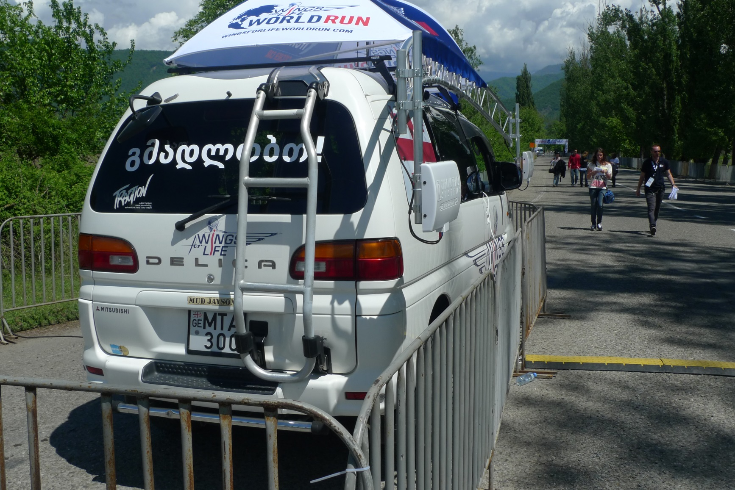
Sportveranstaltungen als Datenlieferant
Wings for Life World Run
Flagship Run
Wings for Life World Run
App Run
Wings for Life World Run
Organized App Run

